Slide 1
CMA’s XBRL based
electronic filing platform
- iFSAH -
Abdullah K. Al-Terkait - iFSAH Project Manger

Slide 2
CMA has embarked on three key strategic initiatives
CMA is currently embarking on national strategic initiatives that would help spur Kuwait’s economy from a frontier to an emerging market.
Capital Adequacy Framework for Licensed Entities
XBRL based Electronic Filing Platform
(iFSAH)
The XBRL Project has been listed as a National Project with the Supreme Counsel for Projects and Developments
Post Trade Model and Planning

Slide 3
Market Needs
Because the world is changing rapidly, information readiness and availability becomes more and more crucial
Information should be inter-exchangeable and not subject to interpretation differences
Technology is more and more capable in supporting these new demands on communication and reporting
Regulators, Investors and other market participants are in need of more accurate and reliable business and financial information that can be delivered promptly to help them make informed financial decisions
Reporting and Review burdens for both the regulatory bodies and filers need to be reduced

Slide 4
Key stakeholders in XBRL initiative
Stock Exchange
Financial & Securities Regulators
Filers - Corporates
Stakeholders
Auditors
Consumers of financial & non-financial data – Analysts / Investors

Slide 5
Efficiency brought about by the XBRL Project to the Kuwaiti Market
CURRENT STATE
TARGET STATE
Listed Company
Capital Markets Authority
CMA
Listed Company
XBRL
Capital Markets Authority
CMA
Mutual Fund
Ministry of Commerce and Industry
MOCI
Mutual Fund
Ministry of Commerce and Industry
MOCI
Non-listed Company
Boursa Kuwait
BK
Non-listed Company
Boursa Kuwait
BK
Brokerage Firm
Central Bank of Kuwait
CBK
Brokerage Firm
Central Bank of Kuwait
CBK

Slide 6
CMA’s objectives from the XBRL Project
The platform
Standardized & Structured
Reporting Elements (Taxonomies)
Electronic Reporting
Filers & Regulators
Reduce Reporting & Compliance Burdens
Improved Processing
Data & Information
Credible & Accurate
Comprehensive
Reliable
Timely
The Market
(All Stakeholders)
Enhanced Transparency
Comparability
Analysis
Accountability
Better Decision Making
Attractive Business and Investment environment

Slide 7
iFSAH’s Competitive advantage
By providing an unique identity tag to a piece of data, the data now not only is readable by humans but also becomes readable by computers. This will allow for the creation of interactive, intelligent data.
E-Paper
E-Service

Slide 8
Universe of reporting entities
28
Licensed Listed
Islamic
10
Conventional
18
156
entities
301
26
Licensed unlisted
Islamic
18
139
entities
Conventional
8
71
Mutual Funds
Islamic
27
Conventional
44
14
Brokerage
Islamic
1
Conventional
13
Islamic
Conventional
162
Listed-unlicensed
Banks and
non financial
Across the various group of entities, it is evident that the split between Islamic and Conventional is almost even

Slide 9
Reporting Domains – Taxonomy Sets
Full Scope
Reporting Domains
The project shall cover both financial as well as non financial reporting domains, and will be implemented over a phased out approach:
1
Financial Statements
4
Corporate Governance
2
Disclosures (Announcements)
5
Anti-Money Laundering
3
General Assembly
6
Capital Adequacy

Slide 10
High Level Overview on the filing activity through the Platform
iFSAH Portal
- System Validation
- Compliance Check
Filers access the iFSAH Platform
Filers Submit Filing
Form Based Filing
Tool Based Filing
No
Audit
Review?
Yes
Instant Dissemination of Information
Auditor Certification
External parties
(BK, CBK, MOCI, Company,..)
CMA iFSAH Repository
CMA Internal Work Flow
Dissemination of Information Post CMA Review

Slide 11
Project Plan Overview – Platform Development
Q1 – April 2016
Q2 – July 106
Q3 – October 106
Q4 – January 2017
Q1 – April 2017
Develop XBRL Taxonomy
Preparation
Pilot taxonomy development
Taxonomy review and recognition
Final Build and Release
Implement XBRL Solution
Preparation
Pilot solution
Phase 2 – Implement complete Business Intelligence Solution
Full solution requirements
Solution Finalization
Programme Governance & Communication and Training
Project Management and Governance
Milestones
Pilot XBRL taxonomy
Pilot XBRL implementation
Full XBRL solution
Legend
Today
Commencement of Roll out plan
Stage Gates
Workshops

Slide 12
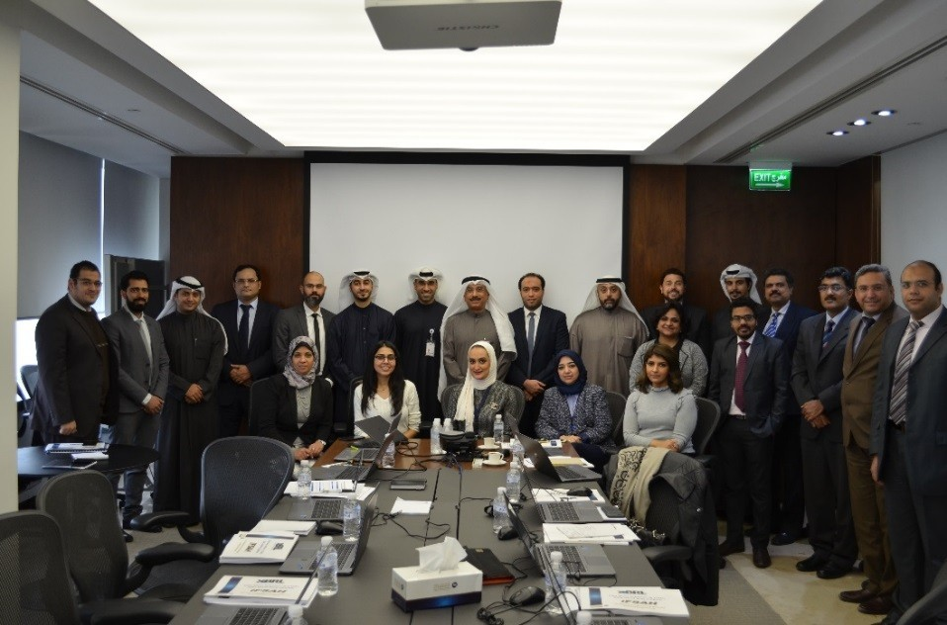
Interaction with the Pilot Group
First awareness raising session
Introduction to CMA’s XBRL project
Second awareness raising session
Highlighted benefits to filers and shared taxonomy templates
Third awareness raising session
Hands on training, and training material provided to all filers
Pilot Go Live!
May ‘16
Jun. ‘16
Jul. ‘16
Aug. ‘16
Sep. ‘16
Oct, ‘16
Nov. ‘16
Dec. ‘16
Jan. ‘17
A representative group of investment firms, mutual funds, brokerages, and auditors were selected.
67
Participants attended

Slide 13
Feedback from the Pilot Group
The general overall satisfaction levels expressed by the users
The Users also expressed their satisfaction with the following:
The experience of using the iFSAH portal. (https:\\ifsah.cma.gov.kw)
1
The experience of using the iFile tool.
2
The comprehensiveness of the IFRS Taxonomy developed for the pilot implementation.
3
The Process of generating uploading and tracking an instance document
4
The helpfulness of the three awareness raising sessions
5
The effectiveness of the iFSAH Hotline and the iFSAH email help desk.
6

Slide 14
Engagement with Stakeholders
FILERS’ Concerns
CMA’s Responses
What is XBRL?
CMA will provide all the necessary tools and solutions to the filers
The tools, solutions and platform will be user friendly
What does this project represent to the filers in terms of:
- Additional burden (cost and effort)?
- Additional compliance obligation?
CMA will provide the stakeholder (mainly filers) with training and awareness workshops and sessions
What is the role of filers in this project? And how do they interact with the other stakeholders in the marker (CBK, MOCI)?
Creating a website dedicated for XBRL in Kuwait
What filings will be covered in the platform?
The platform will cover financial and non-financial filings

Slide 15
Way Forward
Gradual release of the reporting domains
A grace period will be associated with each Reporting Domain
Wide market level awareness and training sessions will be provided to the different stakeholders
1
Dedicated Support Team (helpdesk and Hotline)
2
3
4

Slide 16
Thank You

Slide 17
Customized Entry Points
Pilot XBRL Taxonomy based on IFRS standards
(XXXX concepts)
Securities Activities Including Brokerage
(XX Concepts)
Securities Activities Excluding Brokerage
(XX Concepts)
Brokerage Firms
(XX Concepts)
Mutual Funds
(XX Concepts)
Other Sectors
(Non Licensed Entities)
(XX Concepts)
Conventional
(xx Concepts)
Islamic
(xx Concepts)
Conventional
(xx Concepts)
Islamic
(xx Concepts)
Conventional
(xx Concepts)
Islamic
(xx Concepts)
Conventional
(xx Concepts)
Islamic
(xx Concepts)
Entry Point For Each Sector
(xx Concepts)
Each of the entry points consists of a fixed number of customized taxonomy concepts. The submissions of these templates needs to be compliant with the XBRL Standards set by CMA.

Slide 18
Key development areas that form the XBRL Project
Taxonomy Design & Development
Engagement with Stakeholders
Technology Requirements & Development
Development of business concepts and terminology
Engagement strategy employed to engage with the market
Pilot Phase
Holding workshops and awareness sessions with internal and external stakeholders
Promoting XBRL
Functional requirements
Infrastructure requirements
Filing specifications
A
B
C

Slide 19
Taxonomy Design and Development Pilot Stage
The Pilot Phase was focused on 6 statements from the Financial Reporting Domain
The Financial statements reporting domain is based on the 2016 IFRS Taxonomy
Holds around 4500 concepts
The concepts are reflected in around 64 statements
The templates consisted of the following statements, all of which were shared with the Pilot Group prior to the Pilot Implementation to capture their feedback and comments:
1
Financial position statement
4
Investments at FVTPL
2
Income Statement
5
2 note statements
3
Available for sale statement

Slide 20
Feedback from the Pilot Group
Overall, users were very satisfied with the experience of using the iFSAH portal. Minor enhancements will be performed on the portal. (https:\\ifsah.cma.gov.kw)
Overall, users were satisfied with the comprehensiveness of the IFRS Taxonomy developed for the pilot implementation.
Overall, users were extremely satisfied with the helpfulness of the three awareness raising sessions in preparing them to use the iFile tool and the iFSAH portal.
Overall, users were satisfied with the experience of using the iFile tool. The project teams are currently working together on potential cosmetic and functional enhancements on the same.
Overall, users were extremely satisfied with the experience of generating uploading and tracking an instance document through the platform.
Overall, users were extremely satisfied with the effectiveness of the iFSAH Hotline and the iFSAH email help desk.

Slide 21
Different user profiles for different purposes
1
Company User uploads the XBRL instance document
Filing is available to CBK user for their review
Filing is available to CMA Division Head for further action
Validation successful?
No
Company user to make corrections to the filing based on the errors/comments
Approved
Division Head assigns the filing to 1 of Team Lead under his division
CBK user reviews the Credit portfolio for the filing company, adds comments & accordingly updates status as “Approved’ or “Revision required”
Filing available to Company Super User for approval/rejection
Team Lead assigns the filing to 1 of his staff user for initial review
Approved by CSU?
Rejected
Staff user reviews the filing, adds review comments & submits
Approved
Team Lead reviews the filing & comments from Staff user. Adds his review comments & Submits
Filing available to Audit or Super User (Primary & Secondary both in case dual approval is required) for approval / rejection
End
Division Head reviews the filing & comments from TL & Staff user. Adds his review comments & Submits
Approved by Auditors Super Users?
Rejected
Department Head scans the paper based signed off document provided by Executive Director/Sector Head
Approved
Auditor approved filing available for Company Super User for approval / rejection
Rejected
Department head waits for CBK Status Review
No
Review status received from CBK?
Yes
Approved / Rejected?
Rejected
Rejected
Approved / Rejected?
Approved
Approved
1
Filling gets submitted successfully

Slide 22
Different user profiles for different purposes
Filers
Auditors
Boursa Kuwait
CBK / MOCI
CMA
Company Super User 1
Auditor Super User
BK Super User
CBK Super User
CMA Department/ Sector Head
Company User 1
Auditor User
BK User
CBK User
CMA Business Users
Company User 2

Slide 23
Converting data item into an XBRL item goes through two stages
Standardization
Presentation
النقد والنقد المعادل
Presentation
Comptant et Comptant Equivalents
Presentation
Geld & Geld nahe Mittel
Presentation
Kas en Geldmiddelen
Presentation
现金与现金等价物
Presentation
現金及び現金等価物
Presentation
Cash & Cash Equivalents
Label
cashCashEquivalentsAndShortTermInvestments
References
IAS 7
Instructions
Ad Hoc disclosures
Taxonomy
Item
Data Item
Taxonomy
Item
Calculation
Cash = Currency + Deposits
Formulas Cash ≥ 0
Contexts
KWD
FY2014
Actual
Validation

Slide 24
Think of it as a unique bar code
VS.

